Slide 1
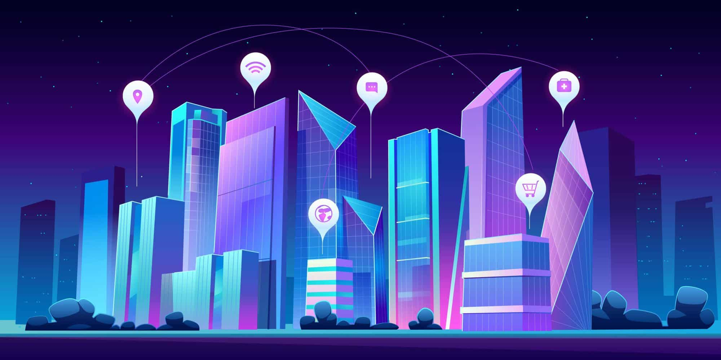
AWS Serverless e Amazon Bedrock com bases de conhecimento, usando dados privados
#ptBr
#CampusParty2024

Slide 2
AWS Serverless and Amazon Bedrock with knowledge bases, using private data
#en-US
#CampusParty2024

Slide 3
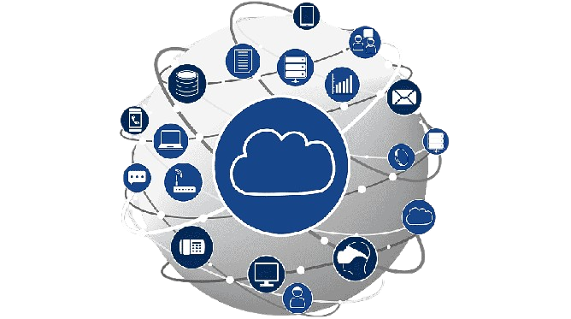

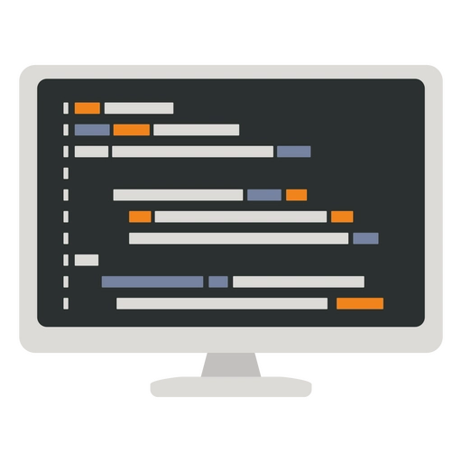


Why Watch this talk?
Cloud is the future
Serverless is the future
Infrastructure as code is the future
Artificial Intelligence is the future
Your future is built in the present

Slide 4








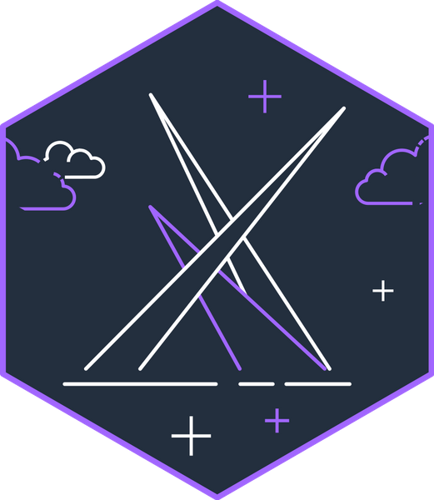











About the Speaker
Weder Mariano de Sousa
Specialist Senior Java - GFT
Serverless
Technician System Development
Graduated Computer Science
https://www.linkedin.com/in/wedermarianodesousa/
Post Graduate in Midias UFG
https://github.com/weder96
Post Graduate in Information Security
https://twitter.com/weder96
GOJava
AWS User
Group Goiânia
https://dev.to/weder96

Slide 5

Agenda
Generative Artificial Intelligence (Gen AI)
Architecture AWS Bedrock
What is RAG (Retrieval-Augmented Generation)?
What will we build?
Knowledge bases
Deploy Infra and Application with CDK
AWS CDK For Java and Python
Next Steps

Slide 6



Generative Artificial Intelligence (Gen AI)
Generative artificial intelligence (Gen AI) refers to a subfield of artificial intelligence that focuses on creating systems capable of generating
new, original content, such as text, images, music, or videos. Unlike traditional AI systems, which analyze and process existing data, Gen AI uses
algorithms to produce novel outputs. This field has various applications, including language translation, image synthesis, and content creation.
Google's researchers have made significant contributions to Gen AI, exploring its potential in tasks like generating human-like conversations
and creating realistic multimedia content. The technology is still in its early stages of development.
Generative artificial intelligence (Gen AI) is rapidly reshaping our world. According to McKinsey, Gen AI's influence on productivity might contribute
trillions of dollars in value to the global economy annually. All industries have the opportunity to benefit from its capabilities, with new applications
emerging daily. Gen AI is poised to have a profound effect on human life across a wide spectrum of sectors, including
healthcare and life sciences. While its potential is undeniable, many organizations are still in the process of exploring possibilities and figuring out
how to effectively integrate Gen AI to create meaningful impacts within their businesses.
DECREASE
COSTS
ATTRACT AND
RETAIN CUSTOMERS
INCREASE
REVENUE
Gen AI is useful when applied to business optimizationopportunities. It can help automate tasks, improve efficiency, and reduce errors that cost time and money.
Gen AI improves engagement through personalized experiences. This leads to attracting new customers along with an increase in brand loyalty and customer lifetime value.
Gen AI is a powerful tool for business innovation. It is used to design new products, services, and solutions that satisfy customer needs and
increase revenue.

Slide 7
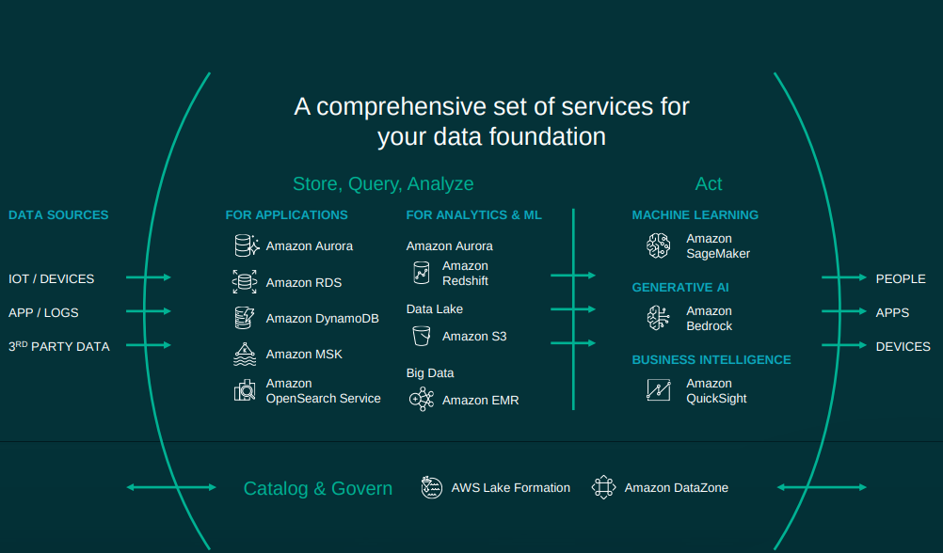

Slide 8

Architecture AWS Bedrock
Topic 2: Presentation of the integration architecture AWS Bedrock

Slide 9
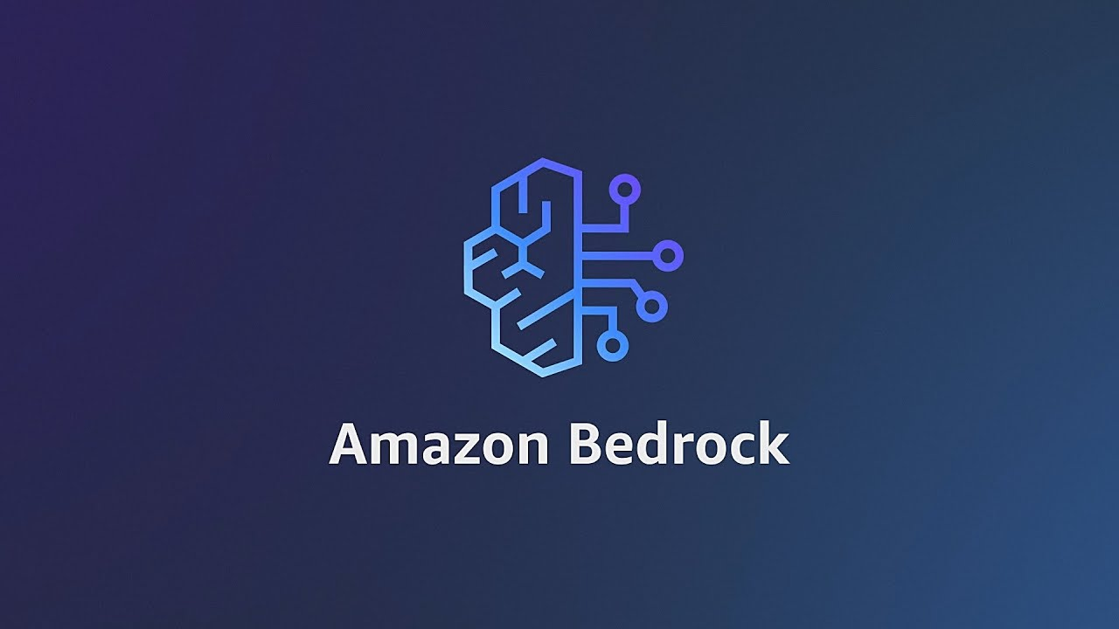

Slide 10


https://aws.amazon.com/pt/bedrock/?did=ap_card&trk=ap_card
Notes:
Amazon Bedrock is a managed platform that enables developers to build generative AI applications with security, privacy, and responsibility. It provides access to high-performance baseline models from leading AI companies such as Anthropic, Cohere, Meta, Stability AI, and Amazon through a single API. Here are some examples of serverless LLM applications that can be built using Amazon Bedrock:
Chatbots
Amazon Bedrock can be used to build chatbots for customer support, virtual assistants, and conversational applications. These chatbots can be integrated with enterprise systems to provide personalized responses and perform complex tasks.
Content Creation
Developers can use Amazon Bedrock to generate content for blogs, articles, and other written materials, as well as create synthetic data for training purposes.
Reflective Dialogue
Models such as Claude FM, available on Amazon Bedrock, are suitable for detailed and reflective conversations, ranging from content creation to complex reasoning and creative writing.
Image Generation
Amazon Bedrock supports the generation of unique, realistic, high-quality images, including artwork, logos, and designs, using models such as Stable Diffusion.
Serverless Document Chat
A specific example is a solution that allows you to ask natural language questions to any uploaded PDF document. It uses serverless services such as AWS Lambda to run LangChain and Amazon DynamoDB for conversational memory. Amazon Bedrock is used to provide serverless access to foundational models such as Amazon Titan and models developed by companies such as AI21 Labs, Anthropic, and Cohere.
Managed Agents
With Amazon Bedrock, you can create managed agents that perform complex tasks using enterprise systems and data sources. These agents can be created in just a few clicks by selecting a base model and providing access to enterprise systems, knowledge bases, and AWS Lambda functions to securely execute APIs.
These are just a few examples of how Amazon Bedrock can be used to build serverless LLM applications. The platform offers a wide range of use cases and tools that allow developers to experiment and evaluate the best base models for their specific needs, customize them with their data, and securely integrate them into their applications.

Slide 11
SIMPLE
SIMPLE
MACHINE LEARNING
INPUTS
OUTPUTS
DEEP LEARNING
COMPLEX
SIMPLE
INPUTS
OUTPUTS
FOUNDATION
MODELS
COMPLEX
COMPLEX
INPUTS
OUTPUTS

Slide 12
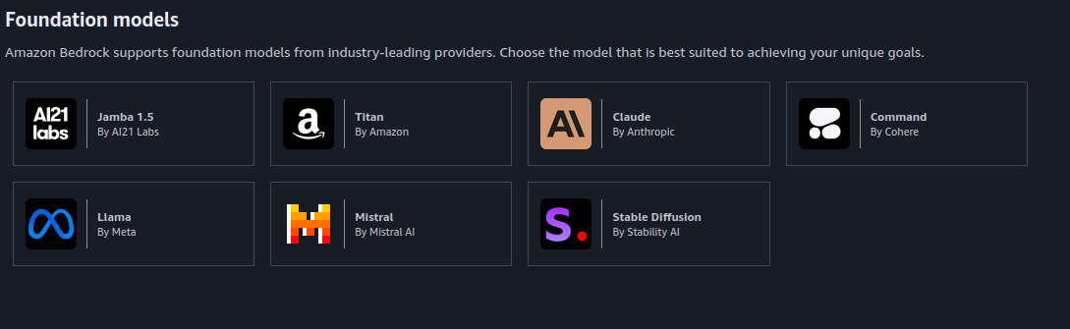
Foundation Models

Slide 13





Amazon Bedrock
The easiest way to build and scale generative AI applications with foundation models
Contextual answers, summarization, paraphrasing
Text summarization, generation, Q&A, search, image generation
Summarization, complex reasoning, writing, coding
Text generation, search, classification
Q&A and reading comprehension
Text summarization, Q&A, text classification, text completion, code generation
High-quality images and art
Jurassic-2 Ultra
Jurassic-2 Mid
Amazon Titan Text Premier
Amazon Titan Text Lite
Amazon Titan Text Express
Amazon Titan Text Embeddings
Amazon Titan Text Embeddings V2
Amazon Titan Multimodal Embeddings
Amazon Titan Image Generator
Claude 3 Opus
Claude 3 Sonnet
Claude 3 Haiku
Claude 2.1
Claude 2
Claude Instant
Command
Command Light
Embed English
Embed Multilingual
Command R+
Command R
Llama 3 8B
Llama 3 70B
Llama 2 13B
Llama 2 70B
Mistral Large
Mistral 7B
Mixtral 8x7B
Stable Diffusion XL1.0
Stable Diffusion XL 0.8
Notes:
With generative AI, every possible workload has a chance to be re invented. We are staring with chatbots and assistants, but as we build new use cases and workflows arise that can be enhanced with generative AI. This is the time to explore what is possible, and push the limits of what we can do. Now is the time to build!!!!

Slide 14
How does a foundation model work?
Data
Foundation model
Text
Images
Speech
Structured data
3D signals
Pre-train
*can take weeks or even months
Fine-tune for specific tasks and domains
*can take hours
Gather data at scale
Evaluate model

Slide 15





Amazon Bedrock Serveless Basic Architecture
AWS Cloud
statics Pages
Amazon S3
Statics Pages
Users
Text Generation
Amazon API
Gateway
AWS Lambda
Amazon Bedrock

Slide 16






Advantages of the Serverless Approach
AWS Cloud
Dump vector index
Upload Document
Amazon S3
Statics Pages
Lambda function
Extract Document Metadata
Amazon SQS
Queue
Lambda function
Embed Documents
Get vector
Dump
Get LLM Response
AWS Amplify Hosting
React Application
Lambda function
Generate LLM
Response
Get Conversation
memory
Client
Amazon API
Gateway
Amazon Bedrock
Authenticate User
Lambda function
CRUD Operations
Amazon Cognito
Amazon DynamoDB
Conversation Memory

Slide 17


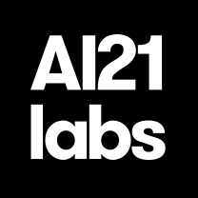









Advantages of the Serverless Approach
Amplify
Get Answer
Amazon API
Gateway
Lambda function
Amazon Bedrock
use
origins
Login
Users
Amazon CloudFront
Amazon S3
Amazon Cognito
React
Voice By
Microphone
text-to-speech
Amazon Polly

Slide 18






Architecture(ECS and Fargate) with Bedrock by Rossana Suarez
AWS Cloud
Amazon S3
(KB Source)
AWS Well-Architected
Tools
Amazon S3
(Iac Templates)
Amazon Bedrock
Knowledge Bases
../wa_genal_iac_analyzer.py
Applicatin
Load Balancing
(Amazon ECS)
AWS Fargate
Amazon Bedrock
AWS Well-Architected
Whitepapers
AWS Lambda
../kb_synchronizer.py
https://github.com/aws-samples/well-architected-iac-analyzer

Slide 19
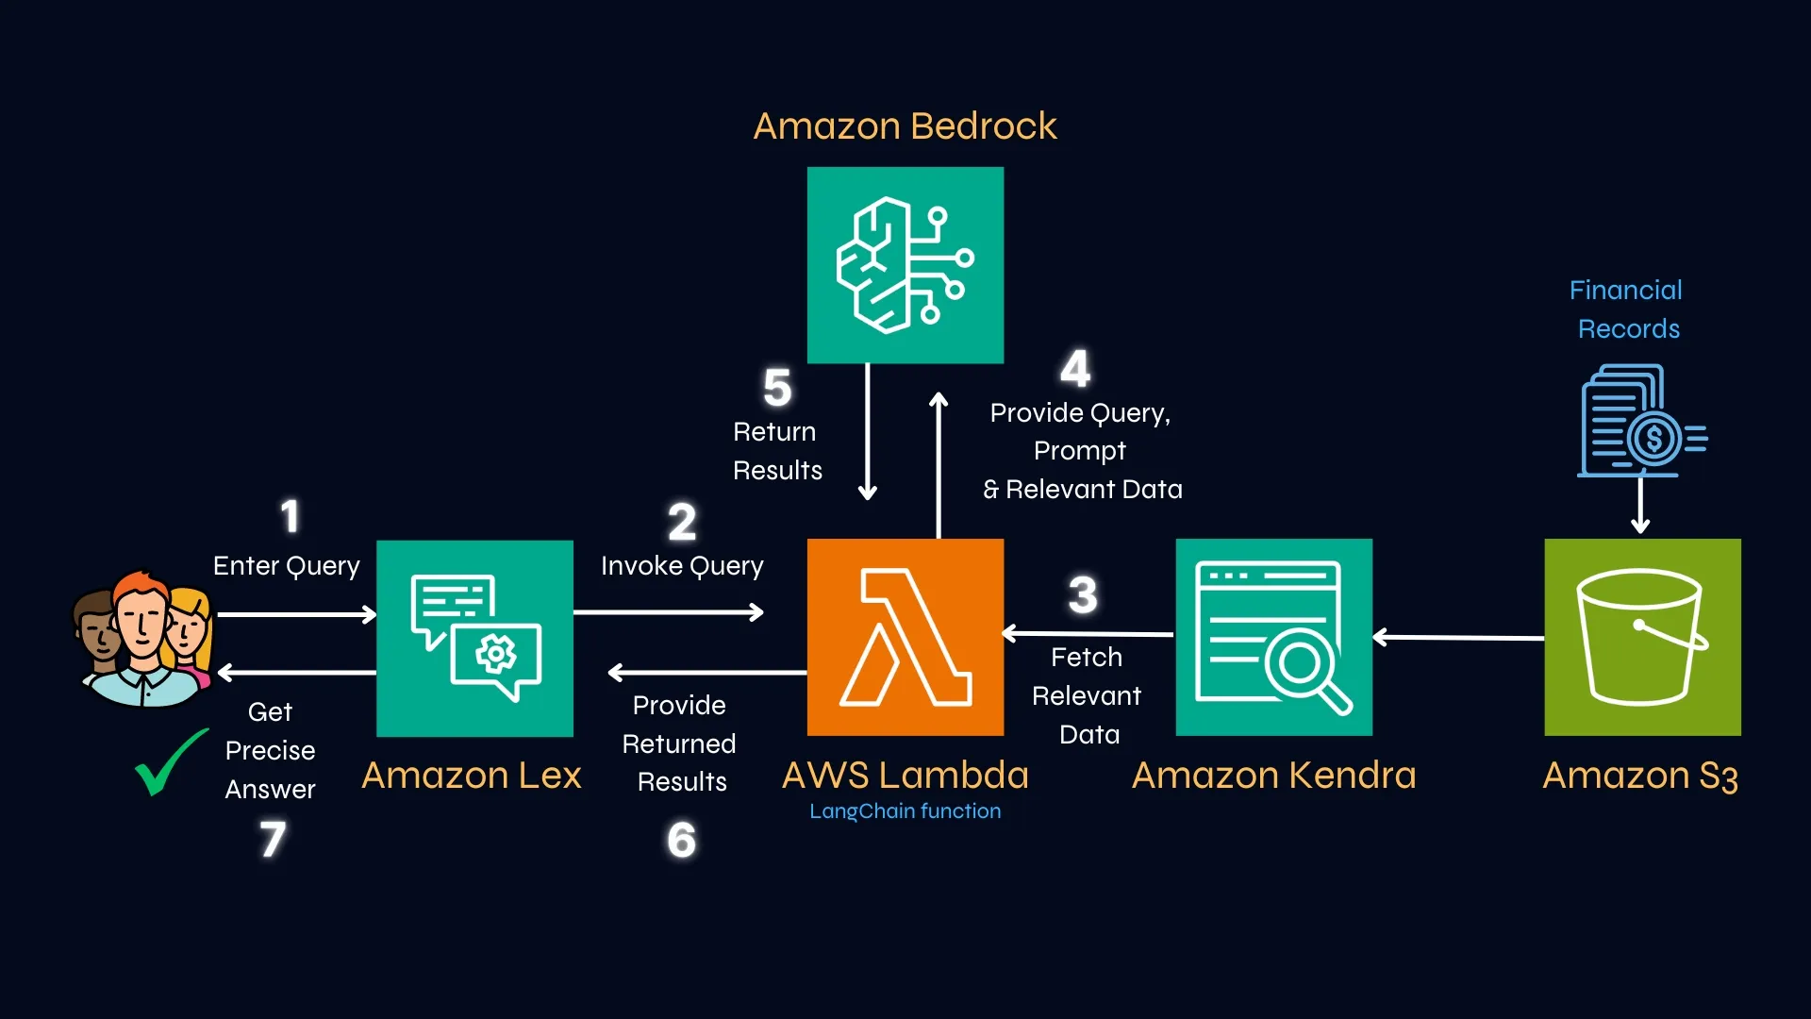

Step into the Future of AI with Amazon Bedrock
https://community.aws/content/2hqMYylVQHtdTNUhQfl23bMRllt/step-into-the-future-of-ai-with-amazon-bedrock

Slide 20

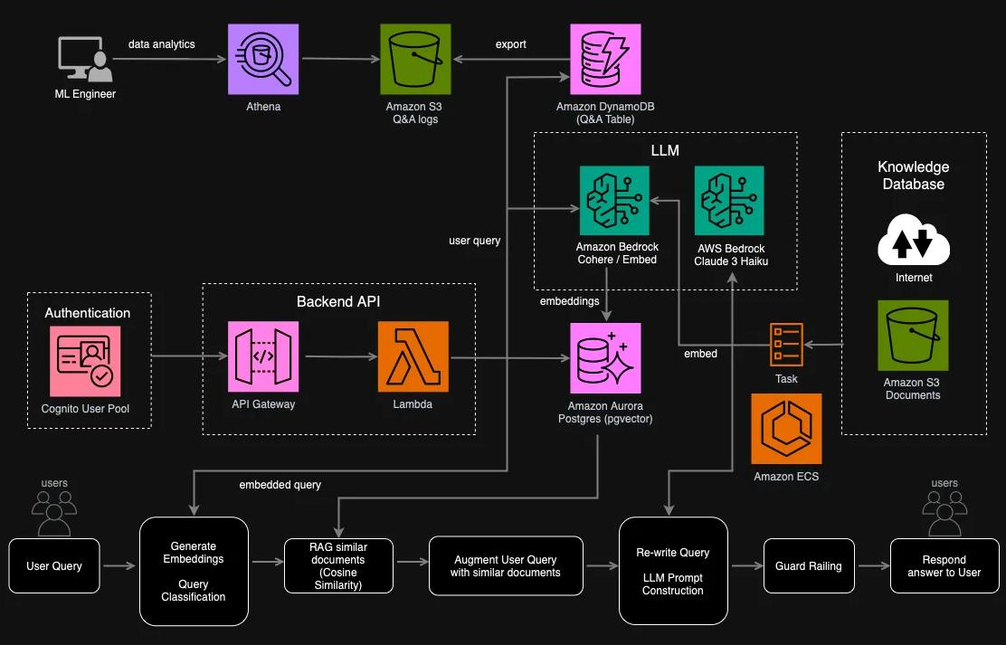
AWS Bedrock Generative AI Application Architecture
https://community.aws/content/2f2d59922DQNz3iH1pCTeudpmhv/aws-bedrock-generative-ai-application-architecture

Slide 21

RAG
RETRIEVAL AUGMENTED
GENERATION

Slide 22
What is RAG (Retrieval-Augmented Generation)?
In Technology there is a name that I consider a Genius and at the same time a visionary, who would this person be?

Slide 23
What is RAG (Retrieval-Augmented Generation)?
He is the creator of the Linux Operating System

Slide 24

What is RAG (Retrieval-Augmented Generation)?
Linus Benedict Torvalds (Helsínquia, 28 de dezembro de 1969) é um engenheiro de software, nascido na Finlândia e naturalizado estado-unidense em 2010
Criador, e por muito tempo o desenvolvedor mais importante do núcleo Linux, sendo utilizado em importantes sistemas Linux, Android e Chrome OS.
É também o criador do Git, sistema de controle de versão amplamente utilizado, e o aplicativo para planejamento e registro de mergulho, Subsurface.

Slide 25

AI Application Architecture - RAG
?
Application
Argument
Prompt
LLM
Vector Store
https://triggo.ai/blog/o-que-e-retrieval-augmented-generation/

Slide 26




Conceptual Flow of using RAG with LLMs
Search Relevant
Information
Knowledge
Sources
2
Query
Prompt
+
Query
Relevant
Information
Enhanced
context
1
3
Generate Text
Response
5
Prompt
+
Query
+
Enhanced
Context
4
Large Language Model EndPoint
https://aws.amazon.com/pt/what-is/retrieval-augmented-generation/

Slide 27
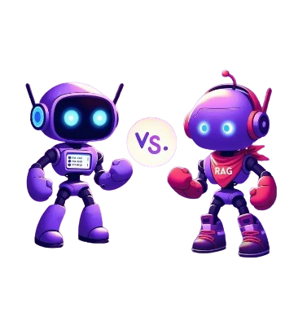

Comparing
RAG v/s Agent AI
RAG chatbots and agent AI:
knowledge-base and Automation
https://yourgpt.ai/blog/general/rag-chatbot-vs-ai-agent

Slide 28


Pre-processing data(Bedrock)
Embedding Model
Splinting into chunks
Generate
Embeddings
Vector DB
Data Sources
Pre-Processing
https://docs.aws.amazon.com/bedrock/latest/userguide/kb-how-it-works.html

Slide 29
Runtime Execution(Bedrock)
Embedding Model
Text Model
Vector DB
Generate
Embeddings
Retrieve similar
documents
Argument User Query with retrieved documents
User Query
Respond to User
https://docs.aws.amazon.com/bedrock/latest/userguide/kb-how-it-works.html

Slide 30

What will we build?

Slide 31


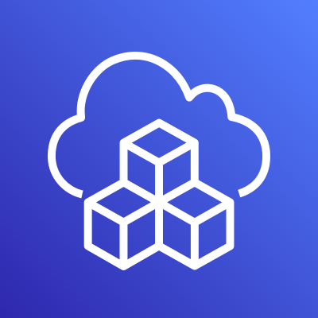

Amazon Bedrock Serveless Architecture
AWS Cloud
Titan Text Embeddings V2
Files (Text)
Amazon S3
DataSources
Amazon Bedrock Knowledge Bases
Amazon OpenSearch
Service
Users
anthropic.claude-3-sonnet
Text Prompt
Amazon API
Gateway
AWS Lambda
Amazon Bedrock Knowledge Bases
CDK(Java)

Slide 32
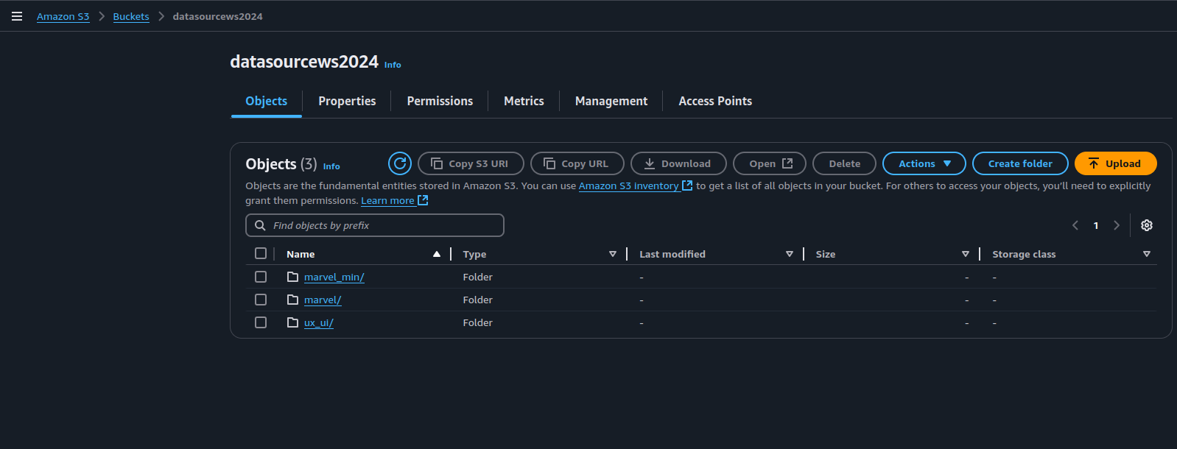
Create Data Source at S3(Storage)

Slide 33
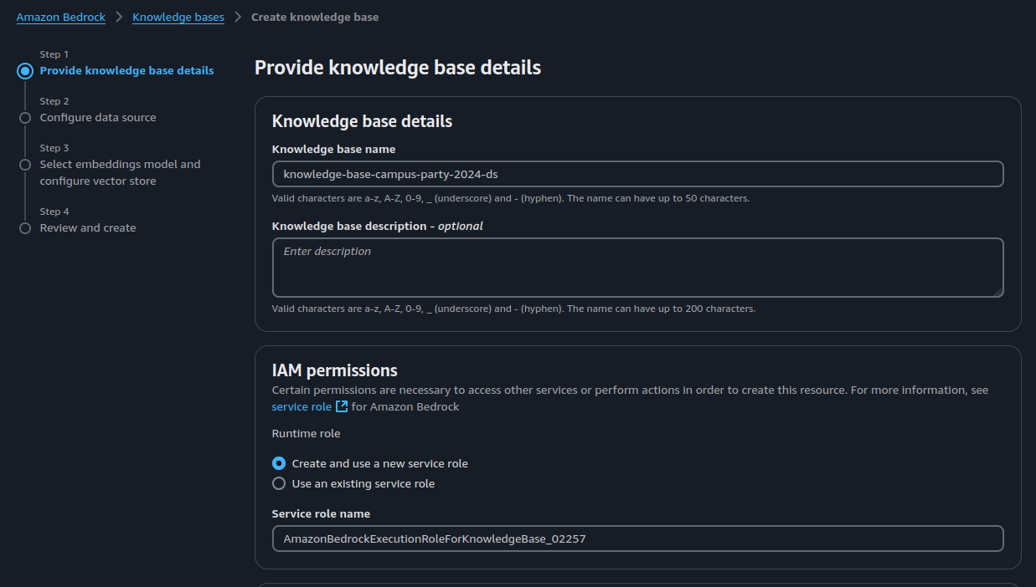
Knowledge bases Steps

Slide 34
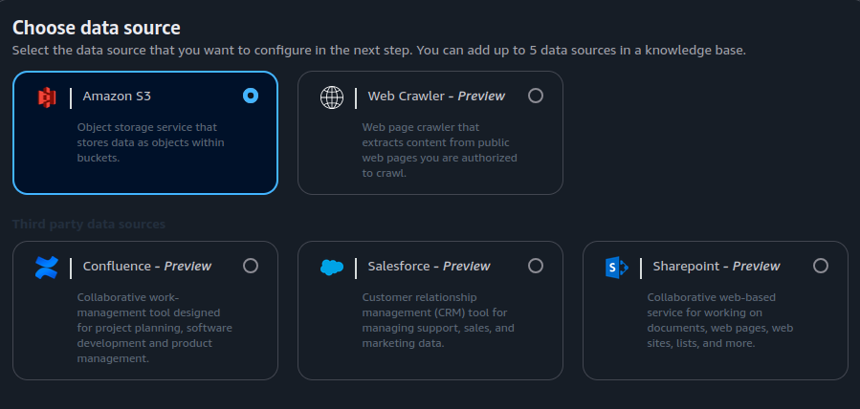
Choose Data Source

Slide 35
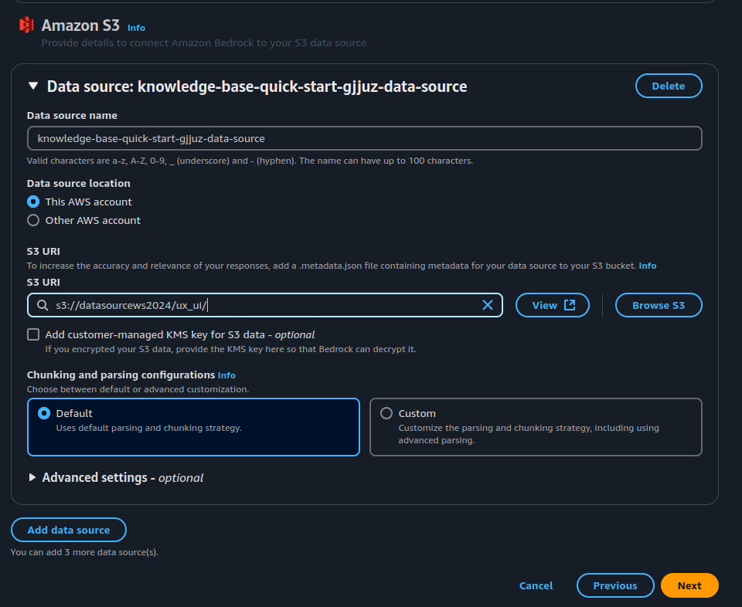
Browser s3 files

Slide 36
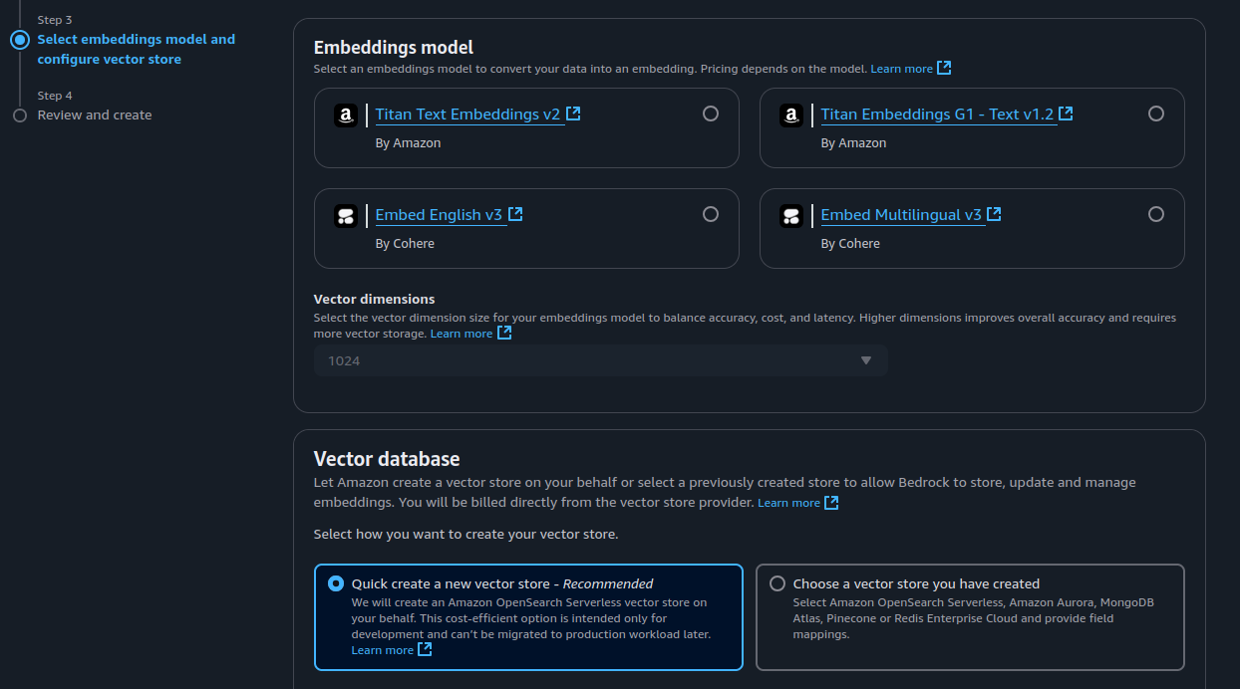
Choosing the model for Embeddings dataSources

Slide 37
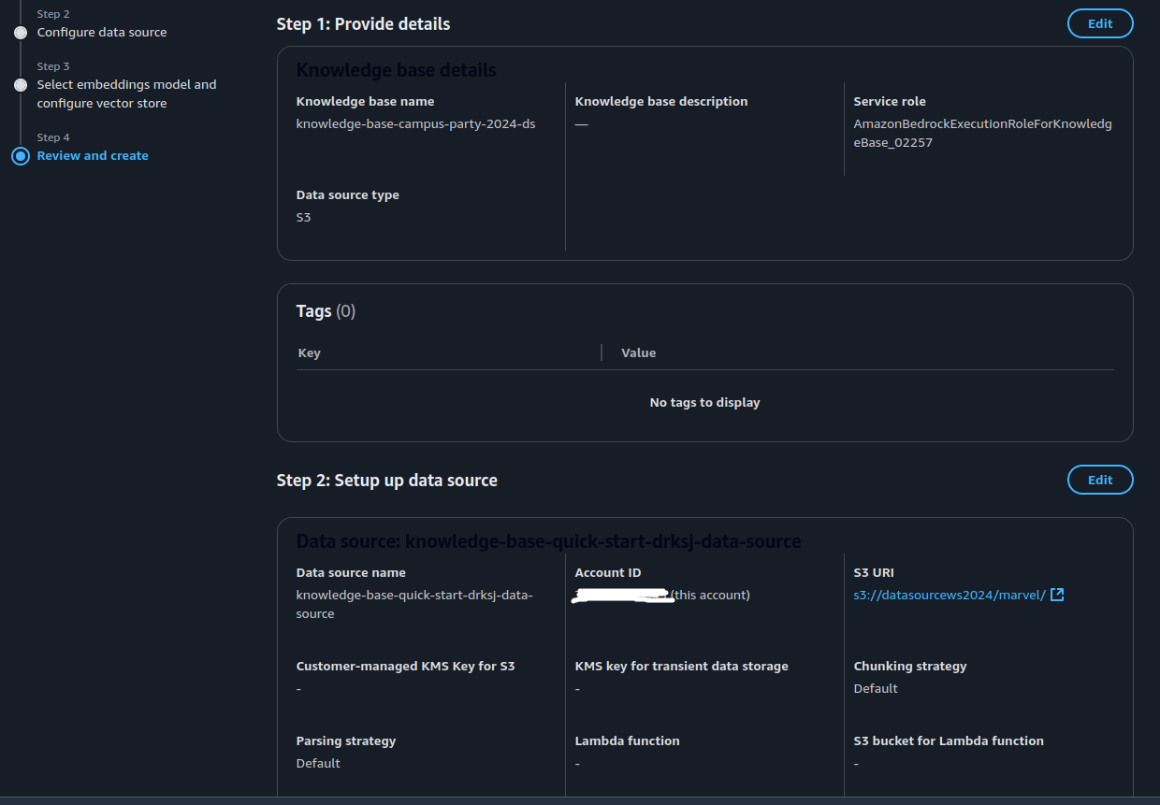
Review and Create

Slide 38
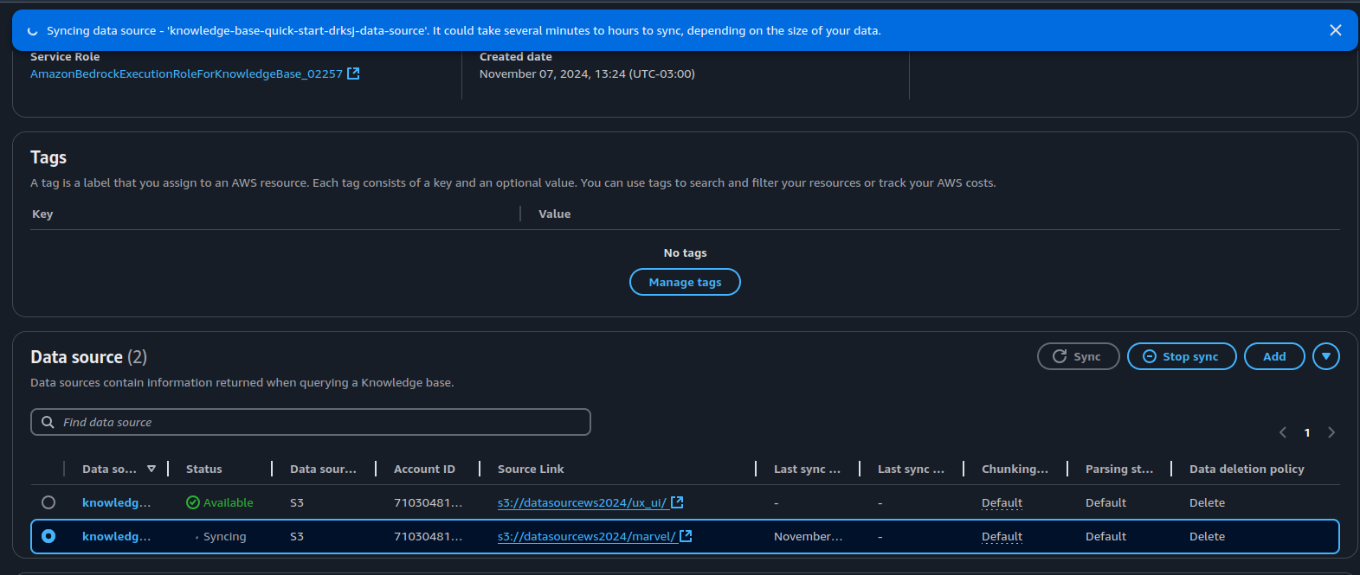
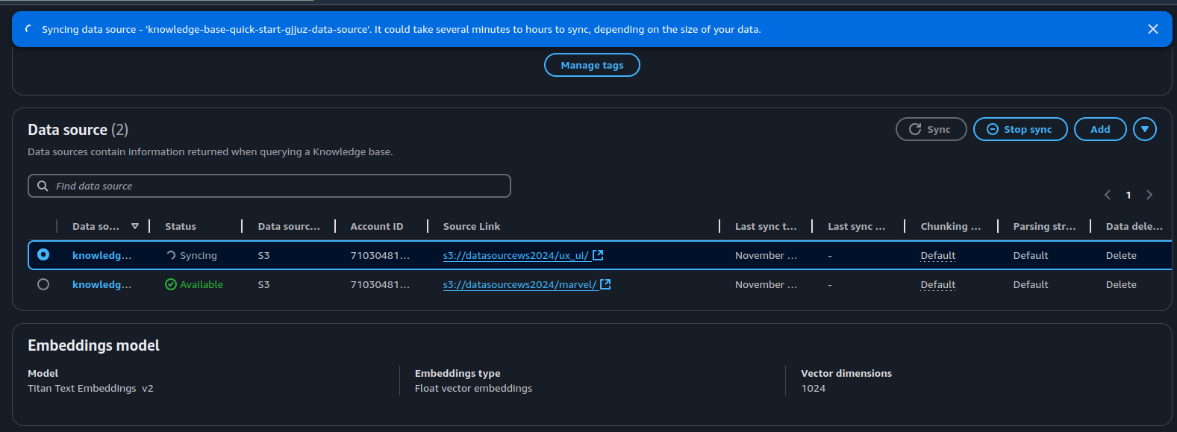
Sync Data Sources

Slide 39
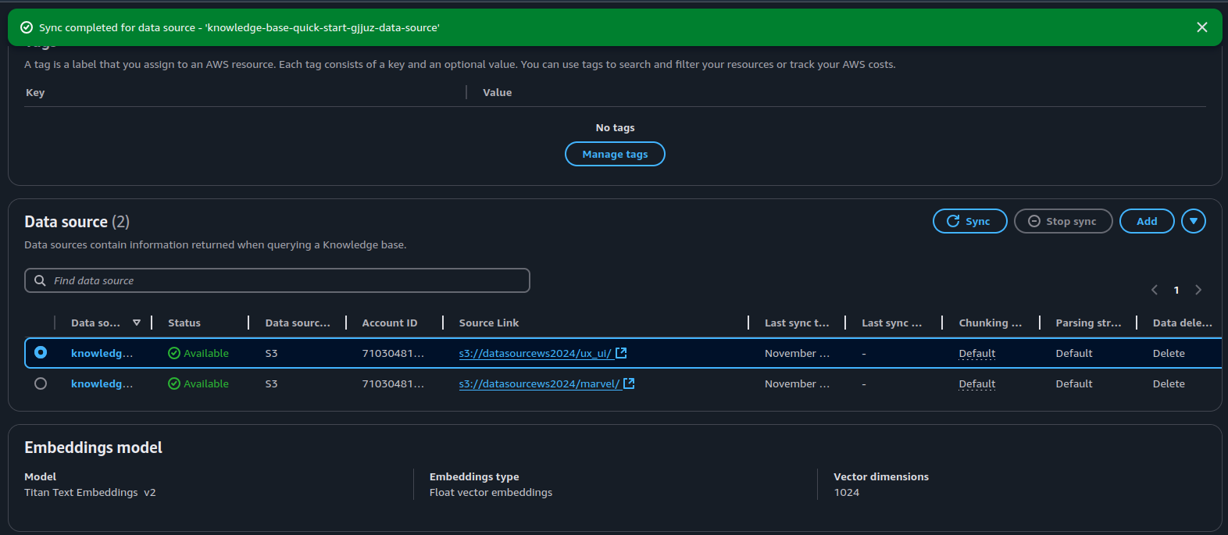
Sync Completed

Slide 40
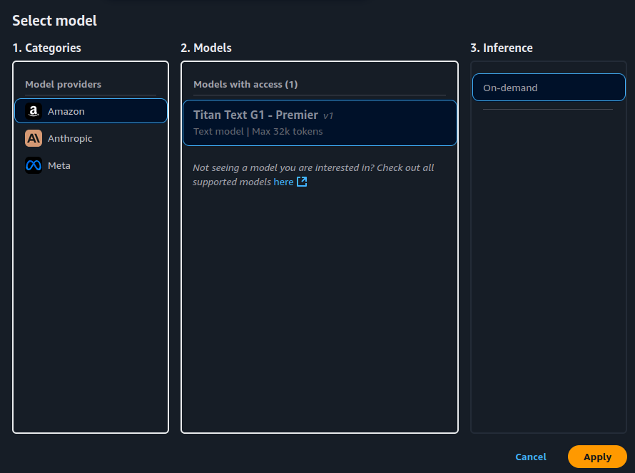
Selected Model And Tests

Slide 41
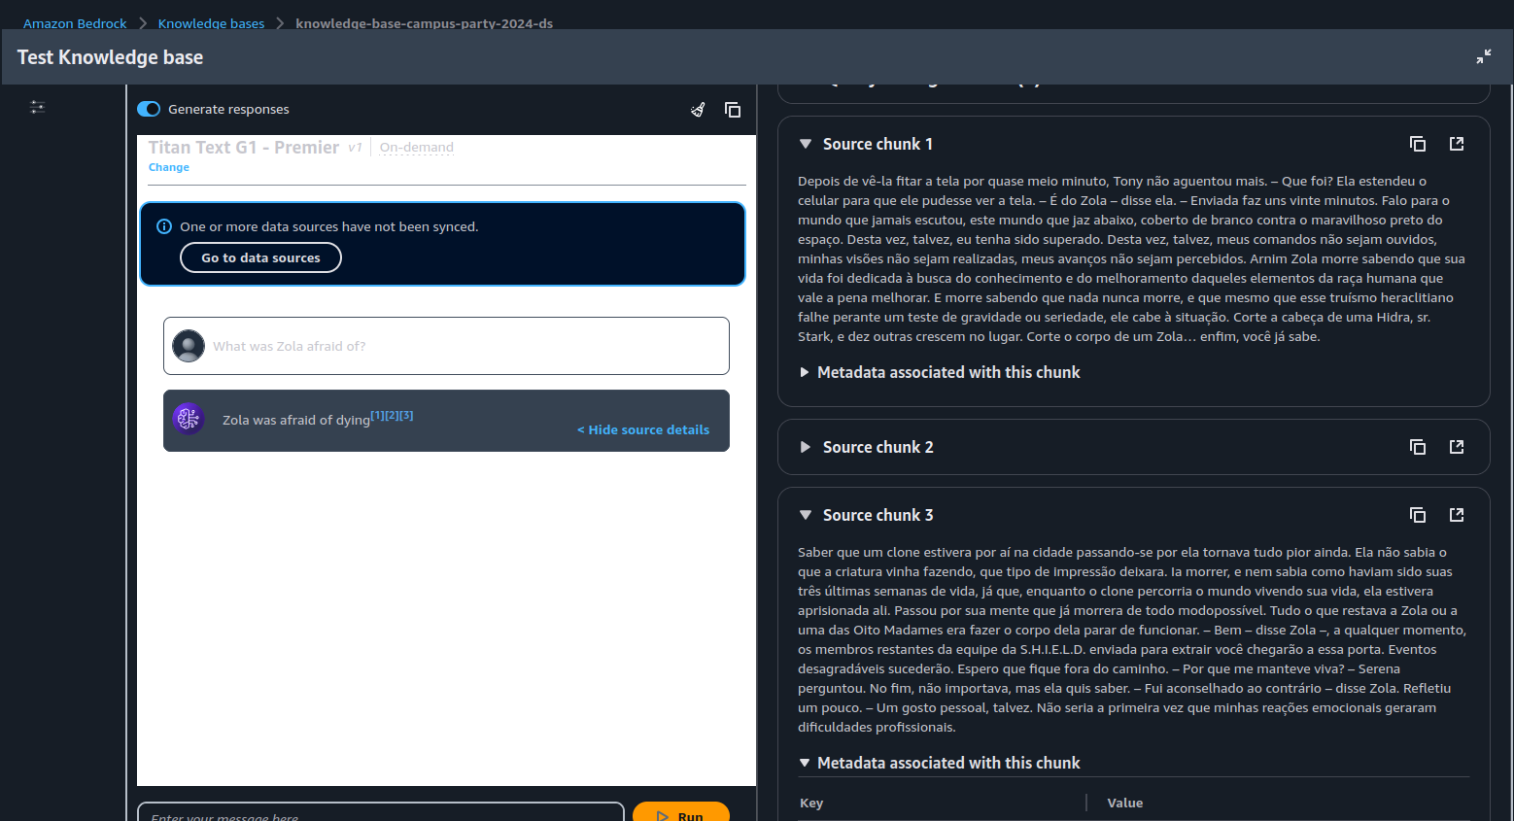
Test Knowledge Base

Slide 42
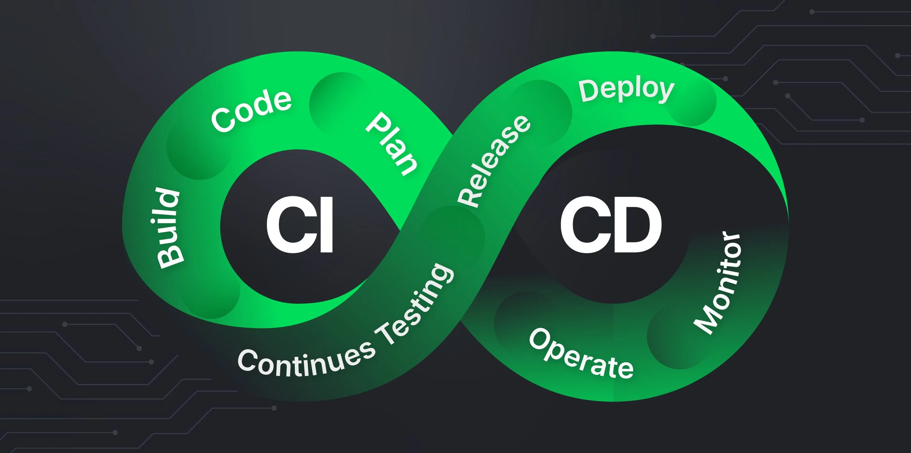

AWS CDK for Java and Python

Slide 43
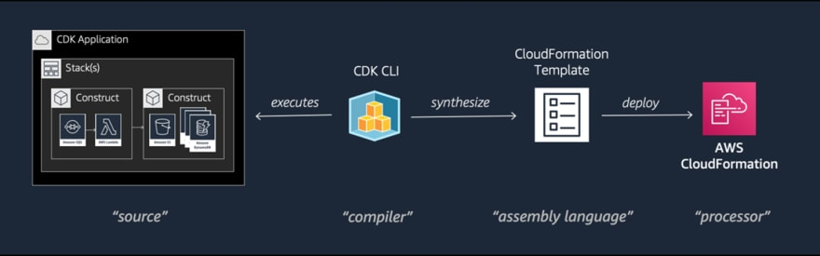
CDK Lifecycle

Slide 44
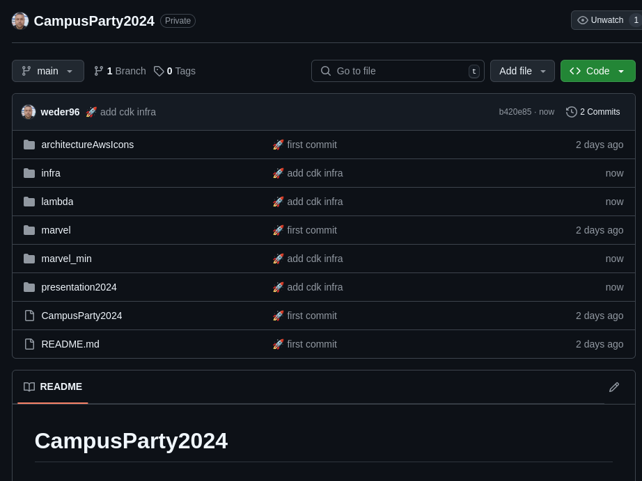
AWS CDK INFRA

Slide 45
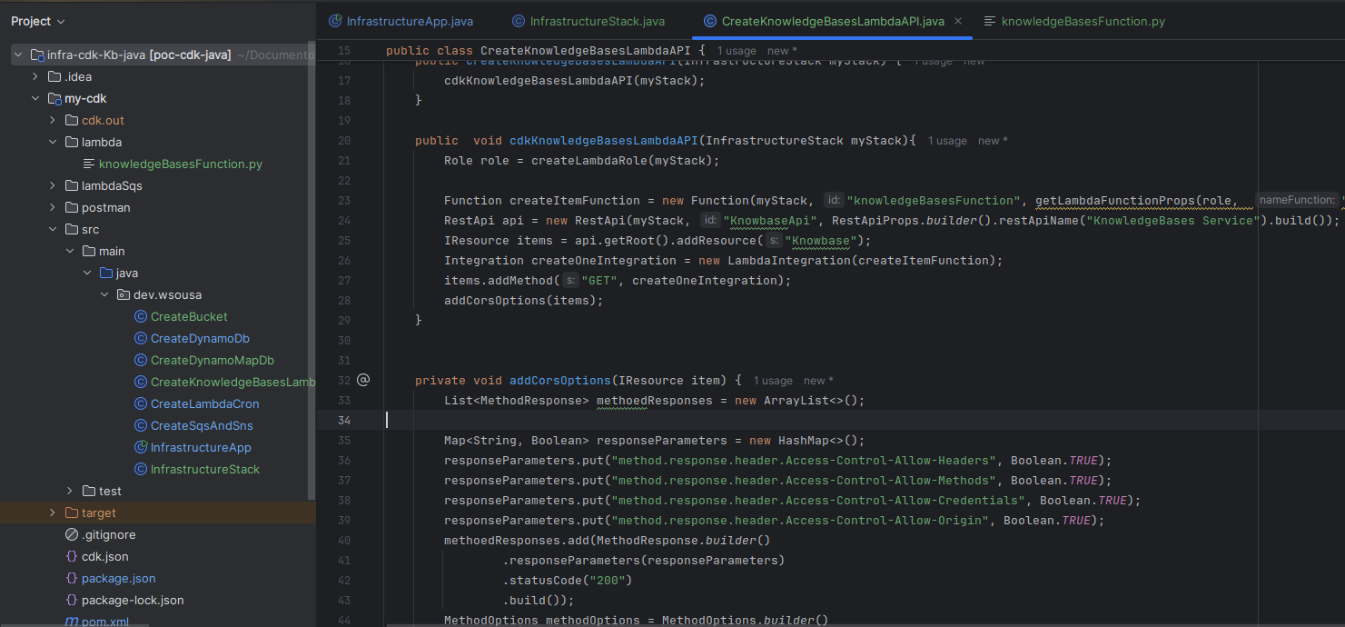
AWS CDK PROJECT

Slide 46
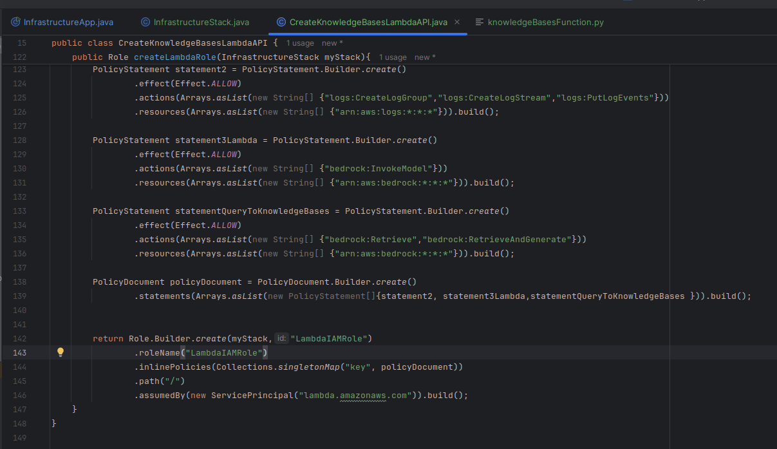
AWS CDK INFRA ROLES

Slide 47
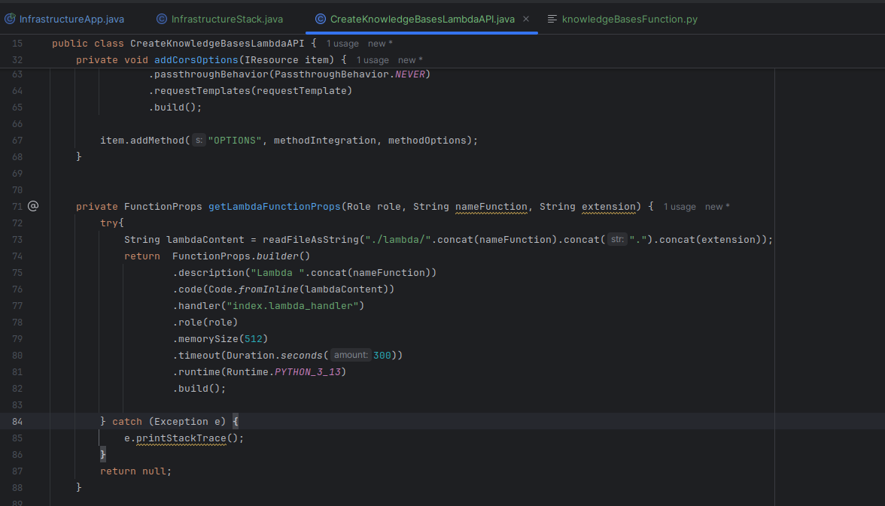
AWS CDK INFRA LAMBDA

Slide 48
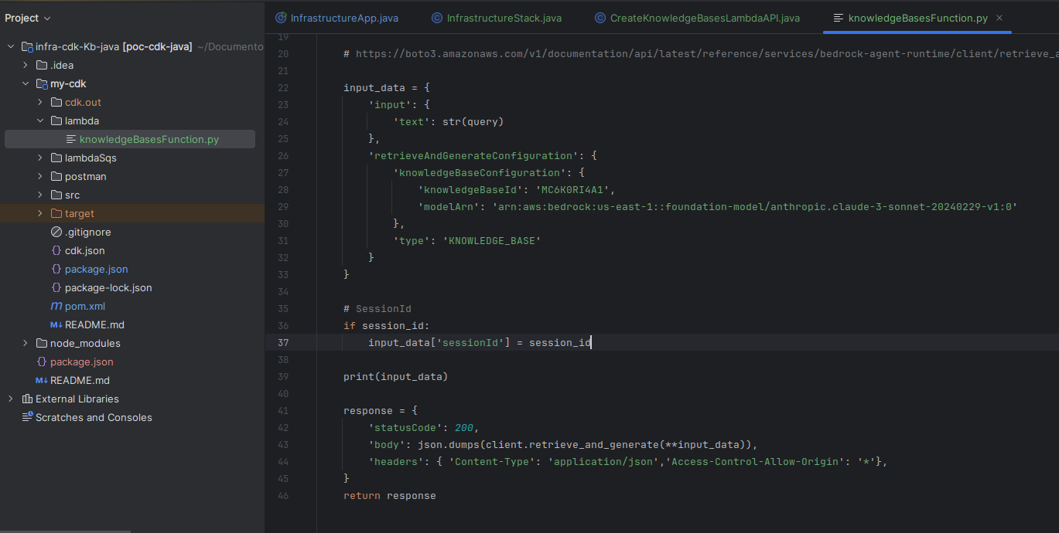
LAMBDA FUNCTION PYTHON
1
2

Slide 49
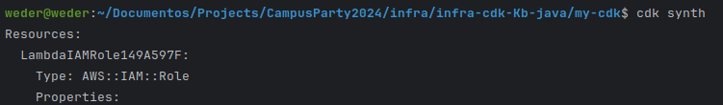
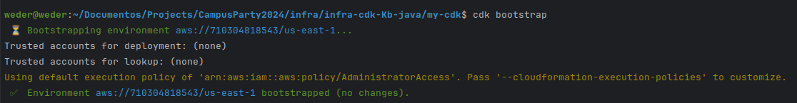
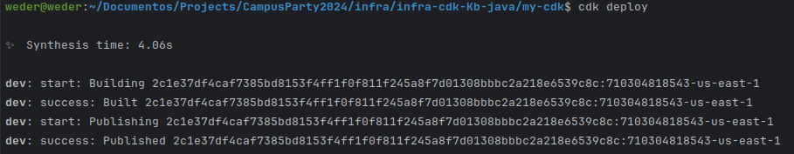
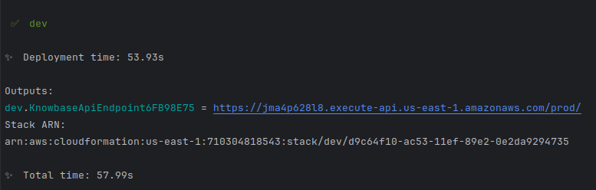
AWS CDK INFRA COMMANDS
1
2
3
1
4

Slide 50
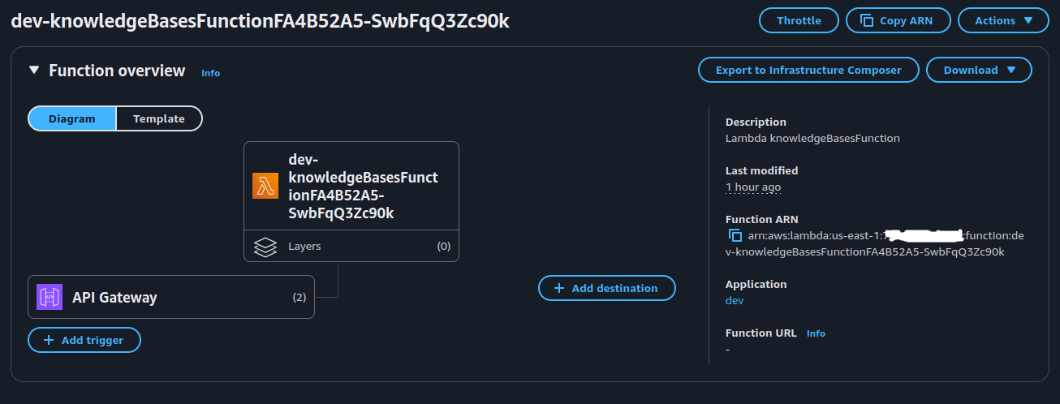

Slide 51
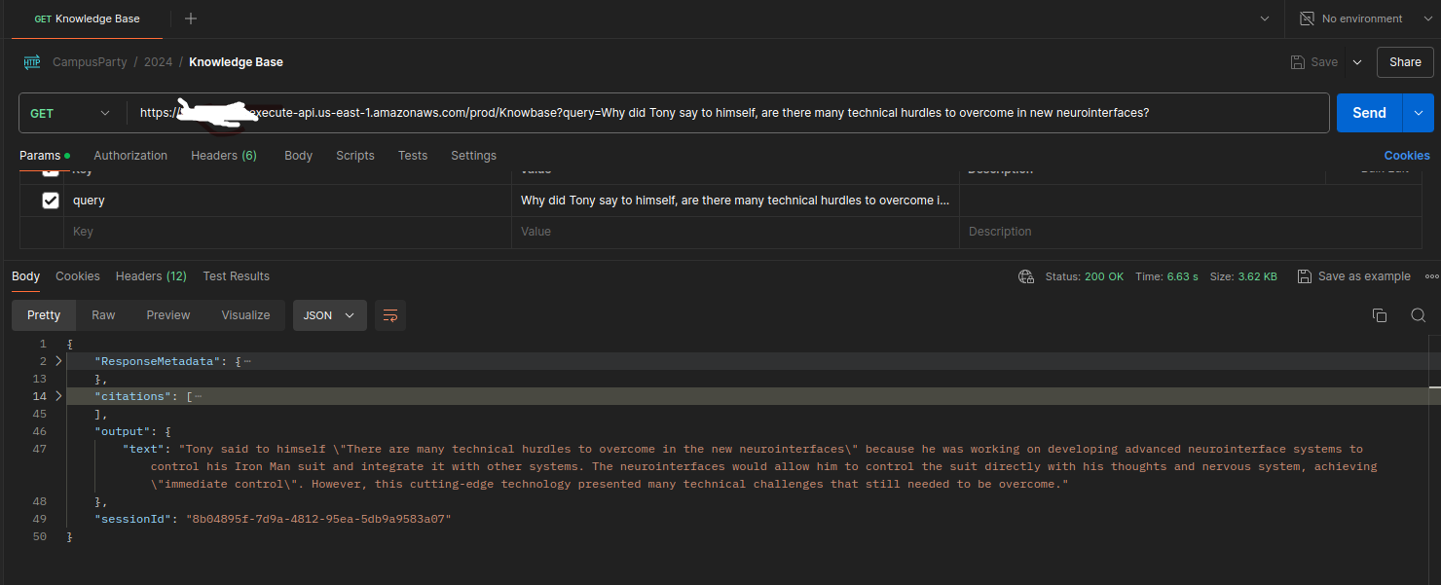
AWS CDK INFRA

Slide 52
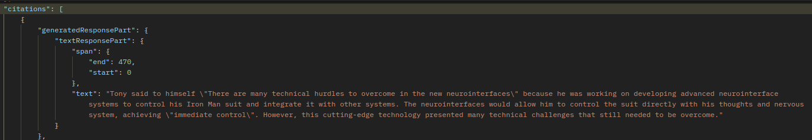
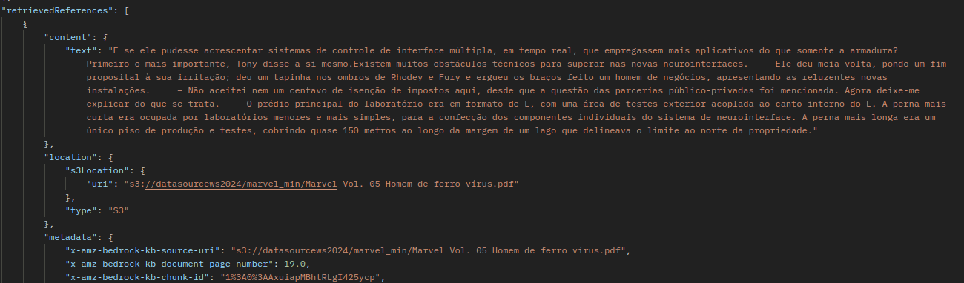
Citations

Slide 53
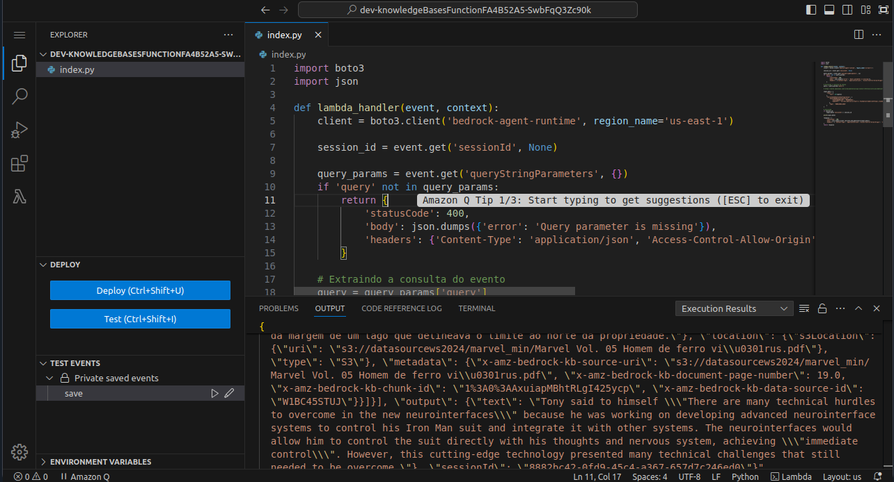
Code Editor Function

Slide 54
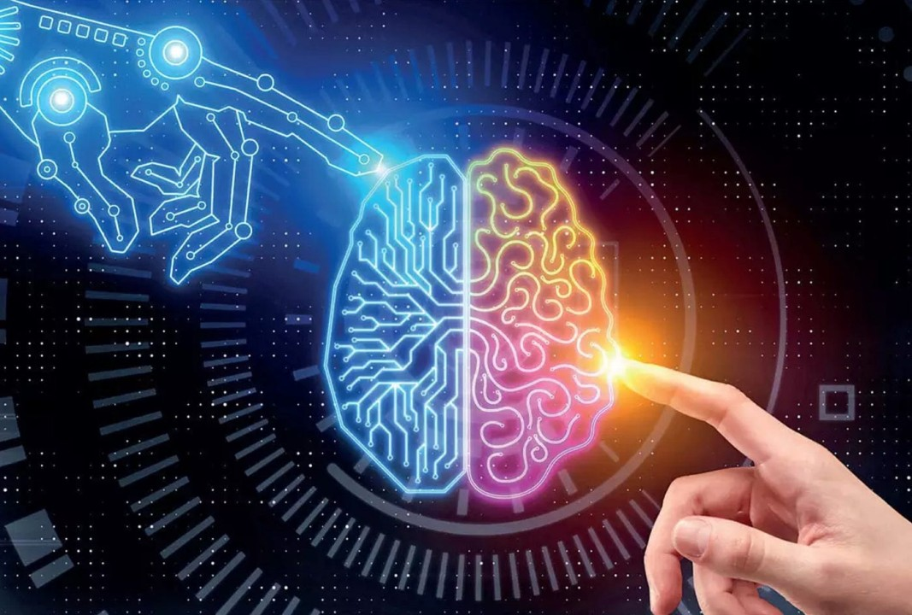
Next Steps

Slide 55
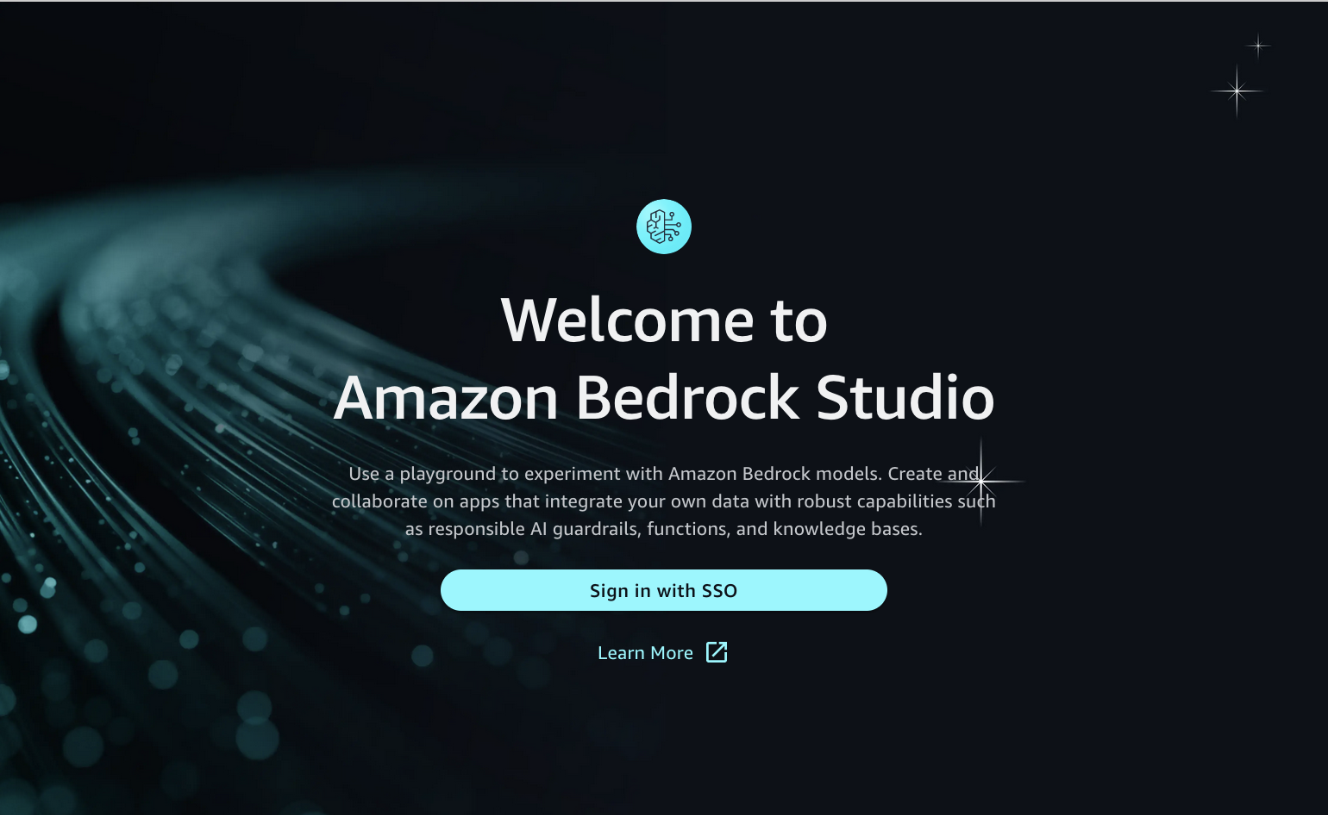

Amazon Bedrock Studio
https://aws.amazon.com/bedrock/studio/

Slide 56
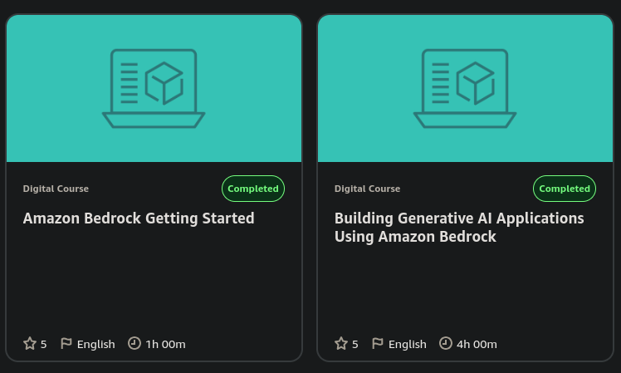

Building Generative AI Applications
AWS Skill Builder
https://skillbuilder.aws/search?searchText=bedrock+badge&page=1&isValidSearchText=true

Slide 57
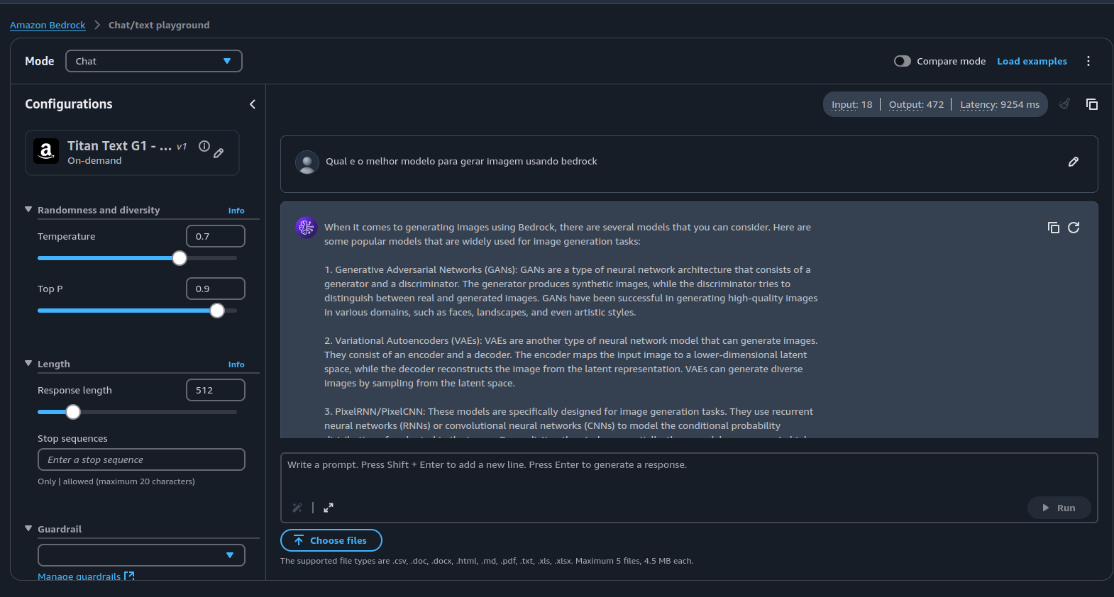
Want to Try?
Chat/text playground
Chat/text playground

Slide 58

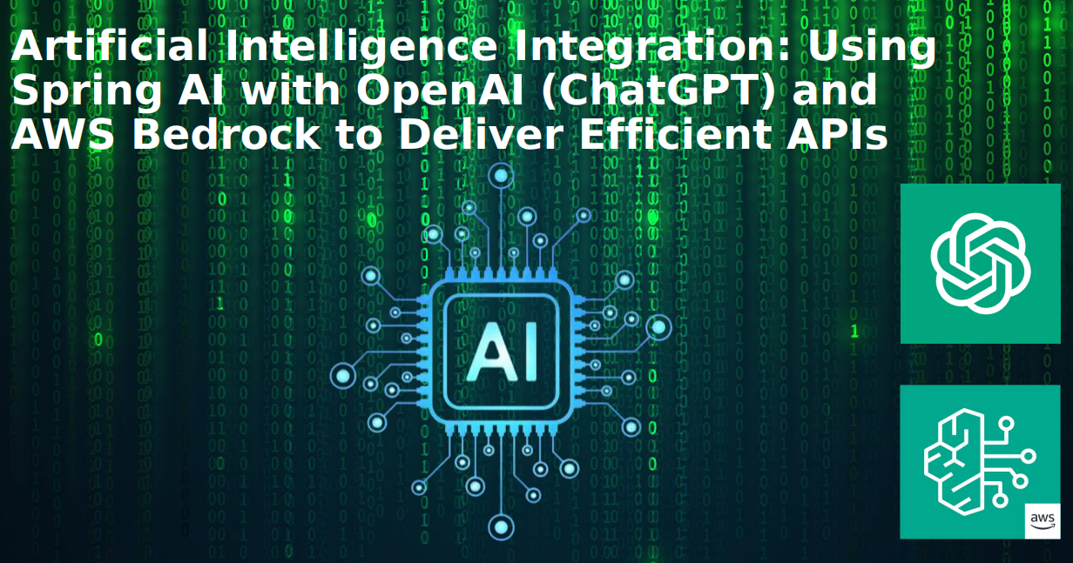
Want to Try?
Artificial Intelligence Integration
https://github.com/weder96/JoinCommunity2024

Slide 59
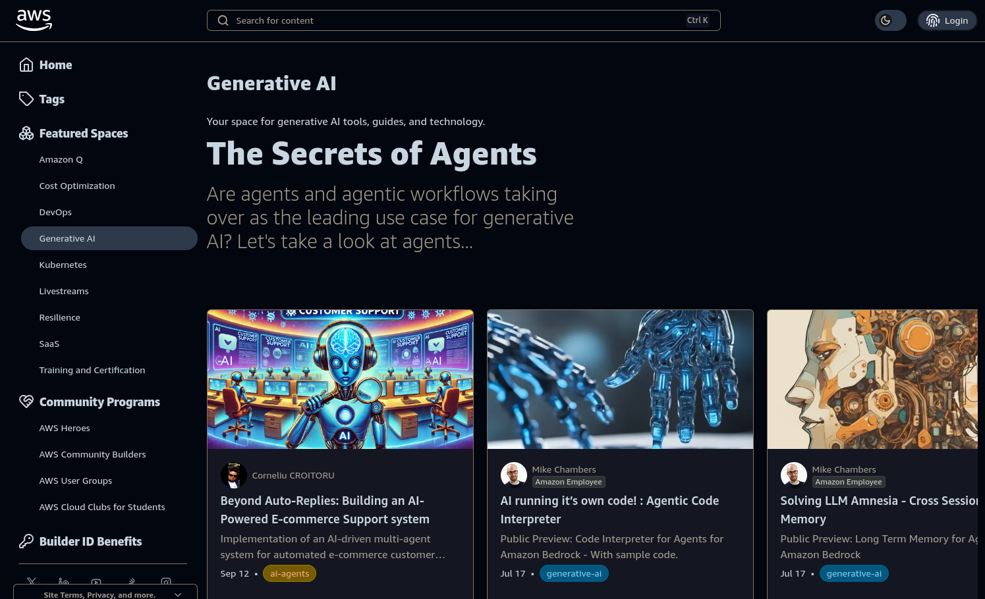

Want to Try?
AWS Community
https://community.aws/generative-ai

Slide 60



Getting started
Get started with Amazon Bedrock
Discover features with a step-by-step tutorial
Dive deep with a
hands-on workshop

Slide 61


GenAI Roadshow - Virtual

Slide 62


Amazon Web Services Latin America

Slide 63
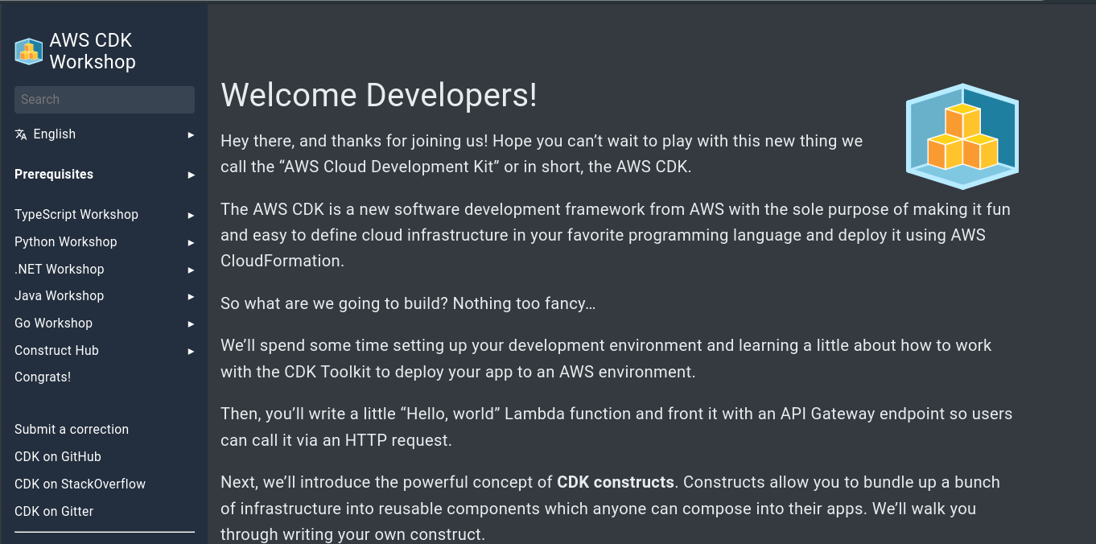

Want to Try?
CDK - Workshop
https://cdkworkshop.com/

Slide 64
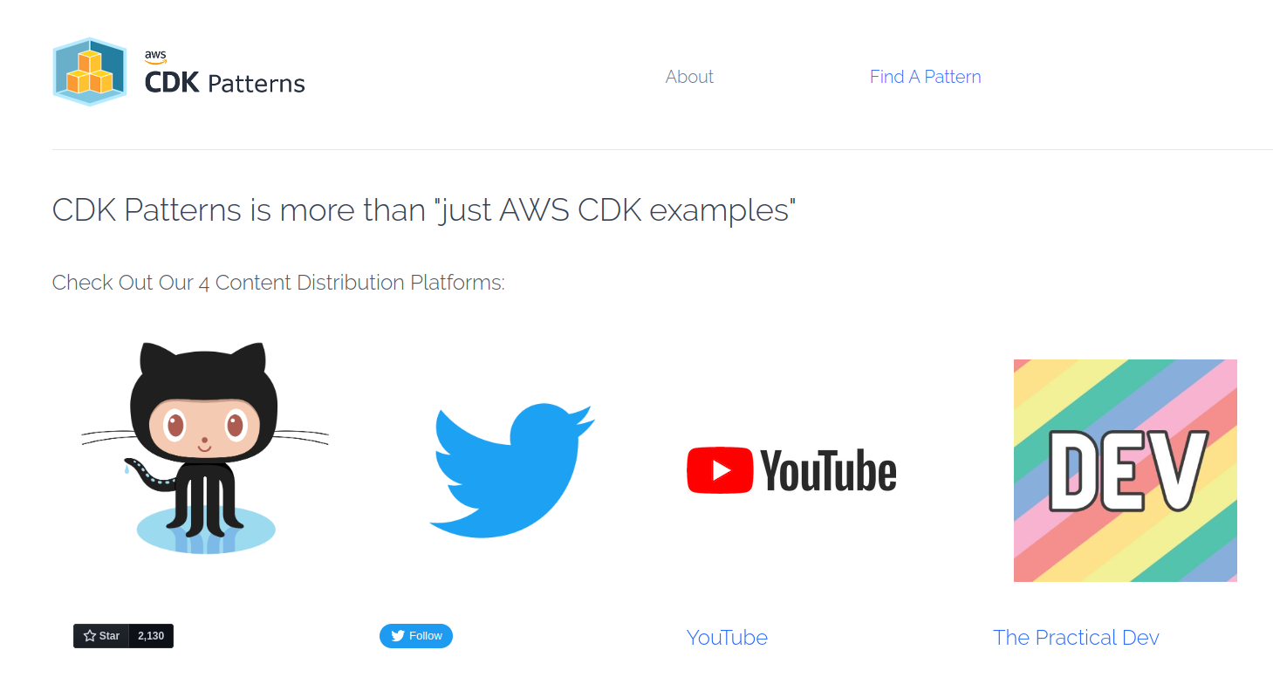

Want to Try?
CDK Patterns
https://cdkpatterns.com/

Slide 65
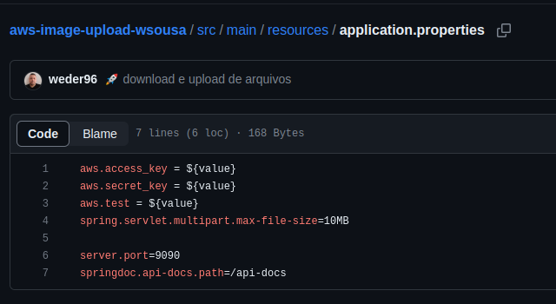
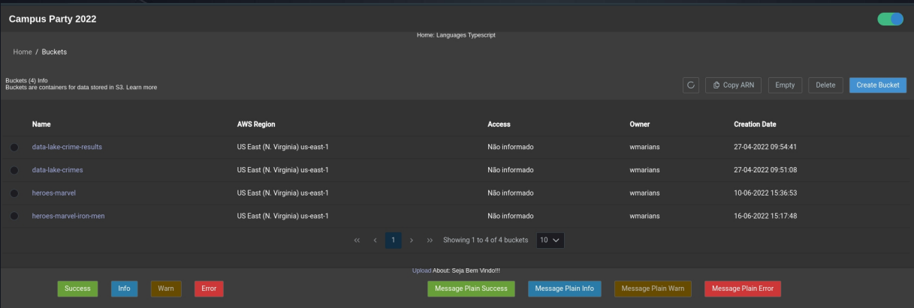

Demo CDK
Clone S3 AWS with CDK
https://github.com/weder96/aws-image-upload-wsousa
https://github.com/weder96/presentationCampusParty2022

Slide 66
Resources
#Links (BedRock)
https://www.ranthebuilder.cloud/post/automating-api-calls-with-agents-for-amazon-bedrock-with-powertools
https://www.slightinsight.com/tech/developing-a-spring-boot-application-with-amazon-bedrock-api/
https://community.aws/content/2dhKdwyY1kzhFTg9CTLbaJ9MmTN/build-generative-ai-applications-with-amazon-bedrock
https://www.eficode.com/blog/building-ai-on-aws-bedrock-brings-brilliant-building-blocks?utm_campaign=AWS&utm_content=189323971&utm_medium=social&utm_source=twitter&hss_channel=tw-142208607
https://cloudacademy.com/learning-paths/integrating-aws-services-with-llms-and-other-fms-14068/
https://www.youtube.com/watch?v=CE_-zrMvcuk&list=PLhr1KZpdzukfmv7jxvB0rL8SWoycA9TIM&index=5
https://programadriano.medium.com/conhecendo-o-amazon-bedrock-c687c7e9777f
https://github.com/AWS-Cloud-Drops-Builders-Edition/show?tab=readme-ov-file
https://levelup.gitconnected.com/ai-powered-video-summarizer-with-amazon-bedrock-and-anthropics-claude-9f1832f397dc
https://catalog.workshops.aws/persona-based-access-genai-application/en-US/04-testing-application/01-updating-code
https://dev.to/aws-builders/have-fun-with-aws-partyrock-3755
https://dev.to/aws-builders/build-serverless-generative-ai-api-service-with-aws-lambda-and-amazon-bedrock-3abc
https://norahsakal.medium.com/how-to-use-aws-titans-ai-multimodal-embeddings-for-better-e-commerce-recommendations-b9f4adb60c02
#Importante
https://www.linkedin.com/pulse/aplica%C3%A7%C3%B5es-serverless-llm-com-amazon-bedrock-diogo-santos-yjo3f/
https://aws.amazon.com/pt/blogs/aws-brasil/crie-aplicativos-de-ia-generativa-usando-o-aws-step-functions-e-o-amazon-bedrock/
https://community.aws/generative-ai
https://aws.amazon.com/pt/what-is/retrieval-augmented-generation/

Slide 67
Resources
#Links Spring AI OpenAI
https://github.com/danvega/hello-gpt/blob/main/src/main/java/dev/danvega/Application.java
https://www.youtube.com/watch?v=yyvjT0v3lpY&list=PLZV0a2jwt22uoDm3LNDFvN6i2cAVU_HTH
https://tecnoblog.net/guias/4-sites-gratis-para-transcrever-video-do-youtube/
#Spring AI Vector
https://www.youtube.com/watch?v=azKntWC6d3w
#Top
https://github.com/kousen/openaidemo
https://www.youtube.com/watch?v=ZeH3bBKdqRU

Slide 68
Resources
https://cdkworkshop.com
https://github.com/aws-samples/aws-cdk-examples
https://docs.aws.amazon.com/cli/latest/userguide/getting-started-install.html
https://aws.amazon.com/pt/developer/language/java/
https://docs.aws.amazon.com/toolkit-for-jetbrains/latest/userguide/setup-toolkit.html
https://aws.amazon.com/pt/intellij/
https://docs.aws.amazon.com/code-library/latest/ug/java_2_code_examples.html
https://docs.aws.amazon.com/pt_br/prescriptive-guidance/latest/patterns/deploy-a-ci-cd-pipeline-for-java-microservices-on-amazon-ecs.html
https://docs.aws.amazon.com/lambda/latest/dg/lambda-java.html
https://aws.amazon.com/pt/blogs/compute/java-17-runtime-now-available-on-aws-lambda/
https://www.slideshare.net/AmazonWebServices/java-on-aws
https://www.jrebel.com/blog/aws-java-application-setup
https://www.slideshare.net/VadymKazulkin/adopting-java-for-the-serverless-world-at-jax-2022
https://towardsaws.com/deploy-spring-boot-application-to-aws-ec2-using-docker-f359e7ad2026
https://aws.amazon.com/pt/blogs/developer/stepfunctions-fluent-api/
https://aws.amazon.com/blogs/compute/java-17-runtime-now-available-on-aws-lambda/
https://docs.aws.amazon.com/lambda/latest/dg/snapstart.html

Slide 69
Q & A
About the Speaker
Weder Mariano de Sousa
Specialist Senior Java - GFT
Serverless
Technician System Development
Graduated Computer Science
https://www.linkedin.com/in/wedermarianodesousa/
Post Graduate in Midias UFG
https://github.com/weder96
Post Graduate in Information Security
https://twitter.com/weder96
GOJava
AWS User
Group Goiânia
https://dev.to/weder96

Slide 70
THANK YOU
Weder Sousa
https://www.linkedin.com/in/wedermarianodesousa/
https://github.com/weder96
https://twitter.com/weder96
https://dev.to/weder96

